Slide 1
About the Freedom to Speak Up Guardian role www.nationalguardian.org.uk #FTSU August 2023

Slide 2
What is Speaking Up?
Speaking up is all of these
Making a disclosure
Raising a concern
Offering a suggestion for improvement
Taking out a grievance
Making a complaint
Whistleblowing
Making a qualifying disclosure

Slide 3
Why is it important?
When things go wrong, we need to make sure that lessons are learnt and things are improved.
If we think something might go wrong, it’s important that we all feel able to speak up so that potential harm is prevented.
Even when things are good, but could be even better, we should feel able to say something and should expect that our suggestion is listened to and used as an opportunity for improvement.

Slide 4
What is Speaking Up?
Speaking up protects patient and worker safety and
experience
But to work, speaking up needs leaders at all levels to Listen Up and Follow Up
Leadership

Slide 5
How to Speak Up
[Our organisation] has a Freedom to Speak Up policy [insert link to how to find your policy]
There are various ways you can speak up
Line manager
Tutor
Lead clinician
Senior Manager
Freedom to Speak Up guardian
HR
Risk Team
Area lead
Your line manager will usually be the first person you might speak up to and is often the best route to use.

Slide 6
Freedom to Speak Up Guardians
Freedom to Speak Up guardians provide another channel for you to speak up to
A guardian will ensure you get feedback on how your matter is handled and used for learning. You will also have the opportunity to provide feedback to them.
They can offer support and help you to escalate the matter
A guardian will thank you and can usually escalate a matter in confidence if you prefer

Slide 7
Who we are
Freedom to Speak Up Guardians work within their organisation to improve speaking up and to ensure that lessons are learnt and things are improved when workers do speak up.
Freedom to Speak Up Guardians are supported by the National Guardian and the National Guardian’s Office who work nationally to improve speaking up within the NHS and healthcare sector in England

Slide 8
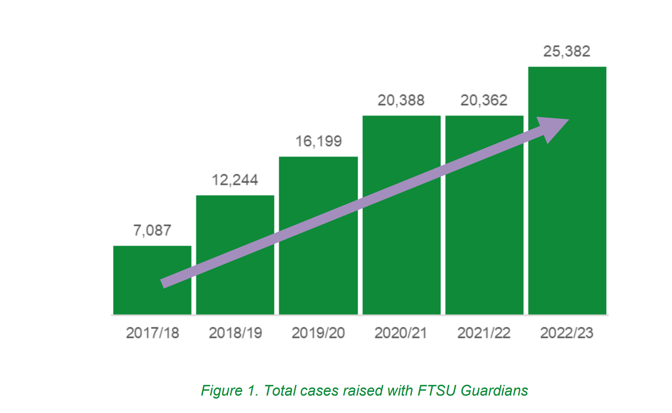
Over 100,000 cases
From 1 April 2022 to 31 March 2023, 25,382 speaking up cases were raised with
Freedom to Speak Up guardians

Slide 9
Headlines 22/23

Slide 10
Headlines 22/23

Slide 11
Find out more
a new e-learning package, is aimed at anyone who works in healthcare in England.
Divided into three modules, it explains in a clear and consistent way what speaking up is and its importance in creating an environment in which people are supported to deliver their best.
Visit https://www.e-lfh.org.uk/programmes/freedom-to-speak-up/

Slide 12
Further information
(Insert Guardian contact details)
Contact the National Guardian’s Office: enquiries@nationalguardianoffice.org.uk
Visit the National Guardian’s Office website:
www.nationalguardian.org.uk
Company/national-guardian's-office
@NatGuardianFTSU
#FTSU

